Slide 1


PYTHON
Lecture 12

Slide 2

Today’s Agenda
Operators In Python
Logical Operators
How Logical Operators Work With Boolean Types ?
How Logical Operators Work With Non Boolean Types ?

Slide 3
Logical Operators In Python
Logial operators are used to combine two or more conditions and perform the logical operations using Logical and, Logical or and Logical not.
Operator | Meaning
and | It will return true when both conditions are true
or | It will returns true when at-least one of the condition is true
not | If the condition is true, logical NOT operator makes it false

Slide 4
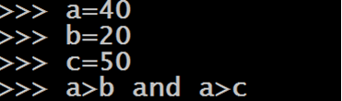
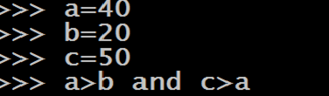
Behavior Of Logical and Operator

Slide 5
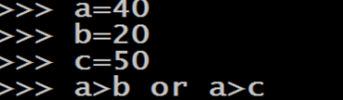
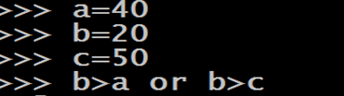
Behavior Of Logical or Operator

Slide 6
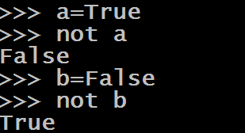
Behavior Of Logical not Operator

Slide 7
Behavior Of Logical Operators With Non Boolean
Python allows us to apply logical operators with non boolean types also
But before we understand how these operators work with non boolean types, we must understand some very important points

Slide 8
Behavior Of Logical Operators With Non Boolean
None, 0 , 0.0 ,”” are all False values
The return value of Logical and & Logical or operators is never True or False when they are applied on non boolean types.

Slide 9
Behavior Of Logical Operators With Non Boolean
If the first value is False , then Logical and returns first value , otherwise it returns the second value
If the first value is True , then Logical or returns first value , otherwise it returns the second value
When we use not operator on non boolean types , it returns True if it’s operand is False( in any form) and False if it’s operand is True ( in any form)

Slide 10
Logical Operators On Non Boolean Types
Example:
5 and 0
Output:
0
Example:
5 and 6
Output:
6

Slide 11
Logical Operators On Non Boolean Types
Example:
6 and 0
Output:
0
Example:
0 and 10
Output:
0

Slide 12
Logical Operators On Non Boolean Types
Example:
‘Sachin’ and 0
Output:
0
Example:
‘Sachin’ and 10
Output:
10

Slide 13
Logical Operators On Non Boolean Types
Example:
‘Bhopal’ and ‘Indore’
Output:
Indore
Example:
‘Indore’ and ‘Bhopal’
Output:
Bhopal

Slide 14
Logical Operators On Non Boolean Types
Example:
10/0 and 0
Output:
ZeroDivisionEror
Example:
0 and 10/0
Output:
0

Slide 15
Logical Operators On Non Boolean Types
Example:
5 or 0
Output:
5
Example:
5 or 6
Output:
5

Slide 16
Logical Operators On Non Boolean Types
Example:
6 or 0
Output:
6
Example:
0 or 10
Output:
10

Slide 17
Logical Operators On Non Boolean Types
Example:
‘Sachin’ or 0
Output:
Sachin
Example:
‘Sachin’ or 10
Output:
Sachin

Slide 18
Logical Operators On Non Boolean Types
Example:
‘Bhopal’ or ‘Indore’
Output:
Bhopal
Example:
‘Indore’ or ‘Bhopal’
Output:
Indore

Slide 19
Logical Operators On Non Boolean Types
Example:
10/0 or 0
Output:
ZeroDivisionEror
Example:
0 or 10/0
Output:
ZeroDivisionError

Slide 20
Logical Operators On Non Boolean Types
Example:
not 0
Output:
True
Example:
not 5
Output:
False

Slide 21
Logical Operators On Non Boolean Types
Example:
not ‘’
Output:
True
Example:
not ‘Sachin’
Output:
False

